Slide 1
Input Devices
Higher National Diploma in Information Technology

Slide 2
Input Devices
Devices which used to input data to the computer are called Input Devices
Examples
Keyboard, Mouse, Webcam, Scanner, Barcode Scanner, Fingerprint Reader, Touch Screen, Kinect Sensor, IRIS Scanner

Slide 3
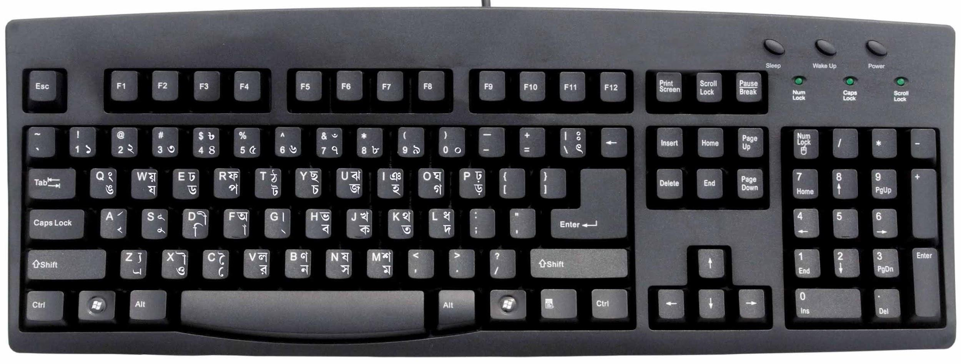
Keyboard

Slide 4
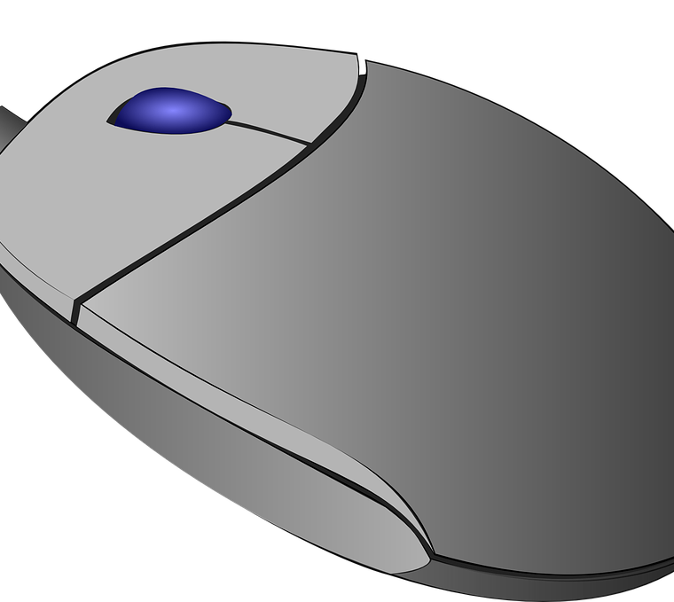
Mouse
There are two types of Mouse
Mechanical Mouse
Optical Mouse

Slide 5
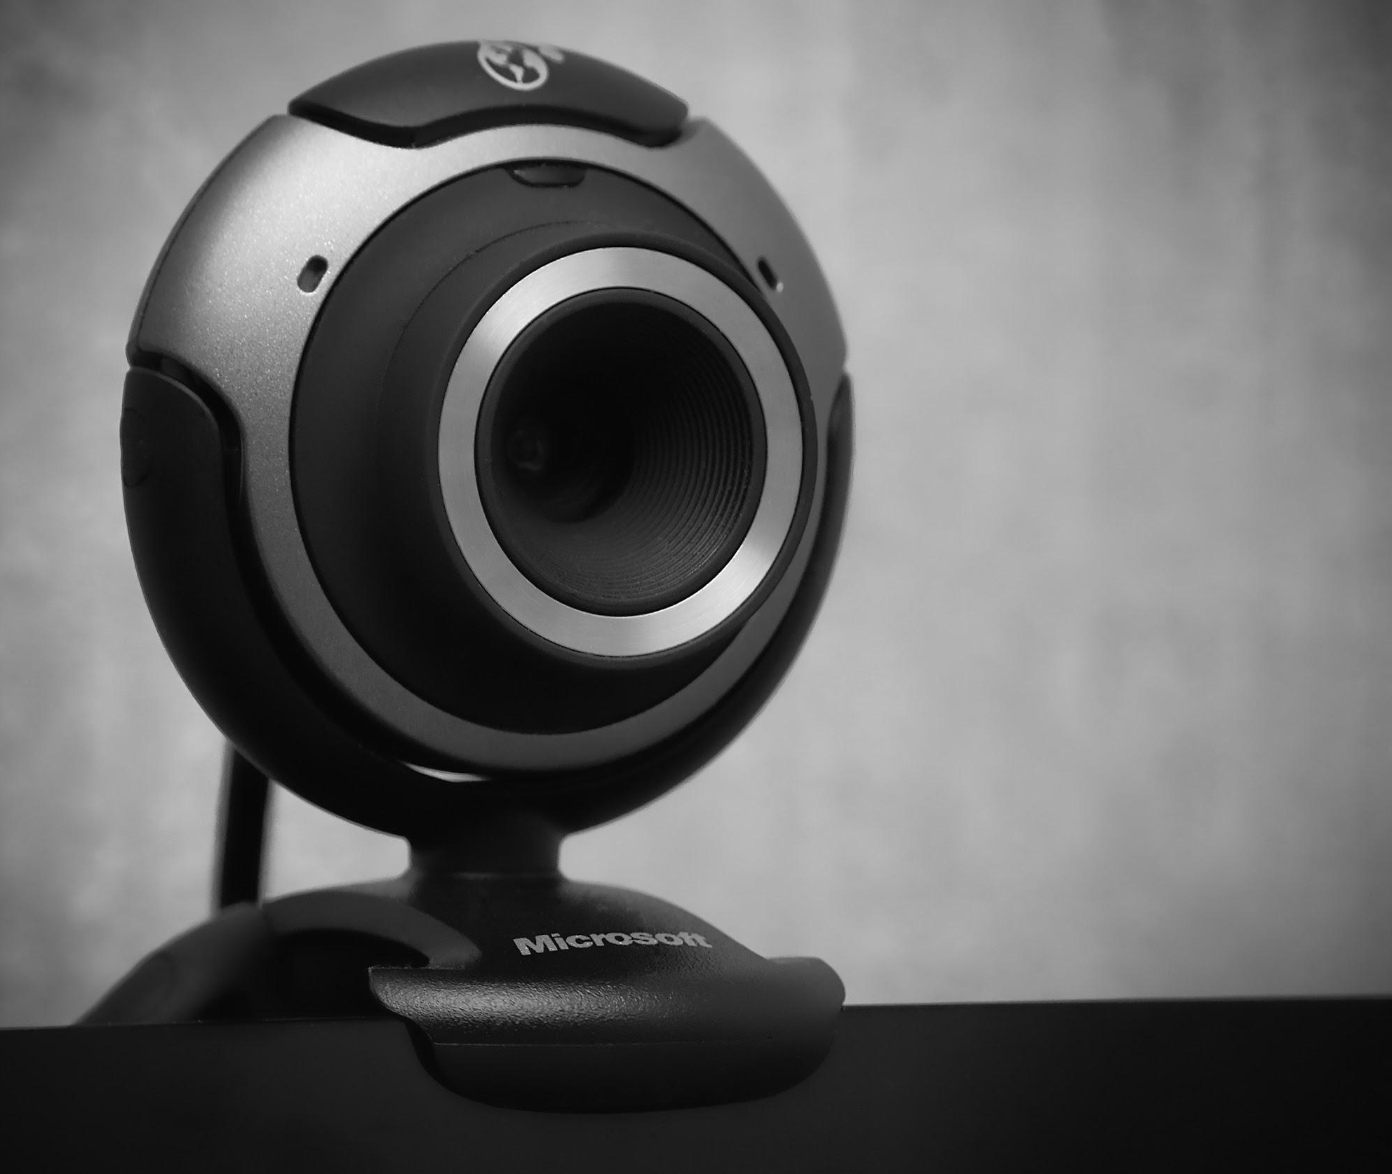
Web Camera
Device Which used to input image or video to computer
Captures images and videos
Security applications and purposes CCTV also used
It uses optical technology to capture images

Slide 6
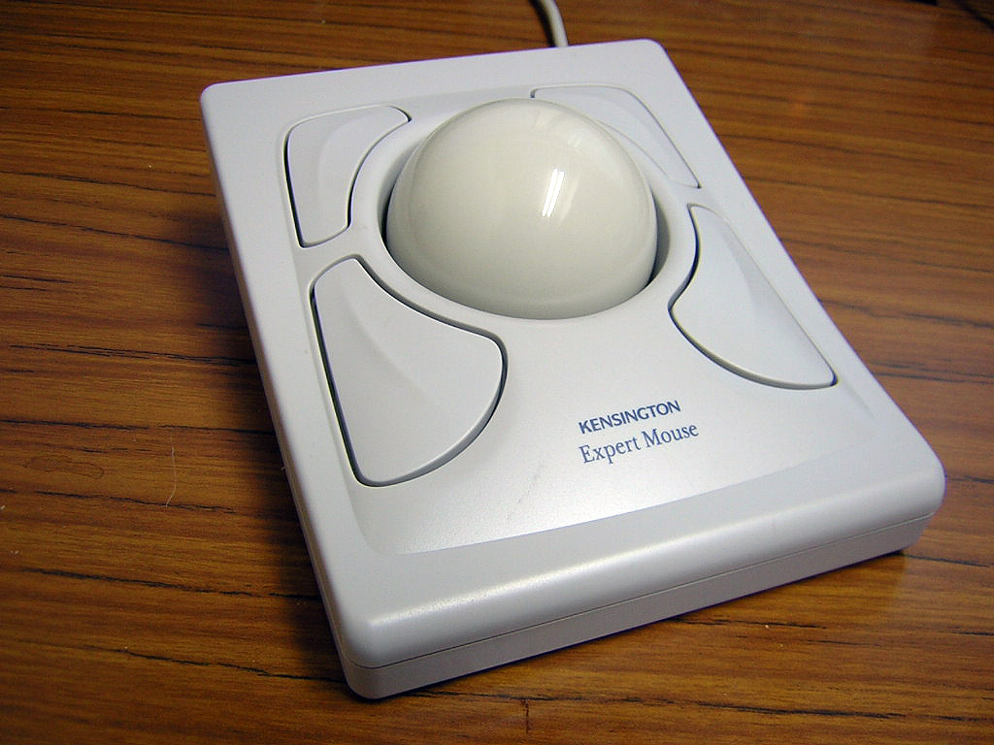
Track ball
Input device used to input mouse movements to the computer
The sphere can be moved with fingertips and can change the position of mouse pointer

Slide 7
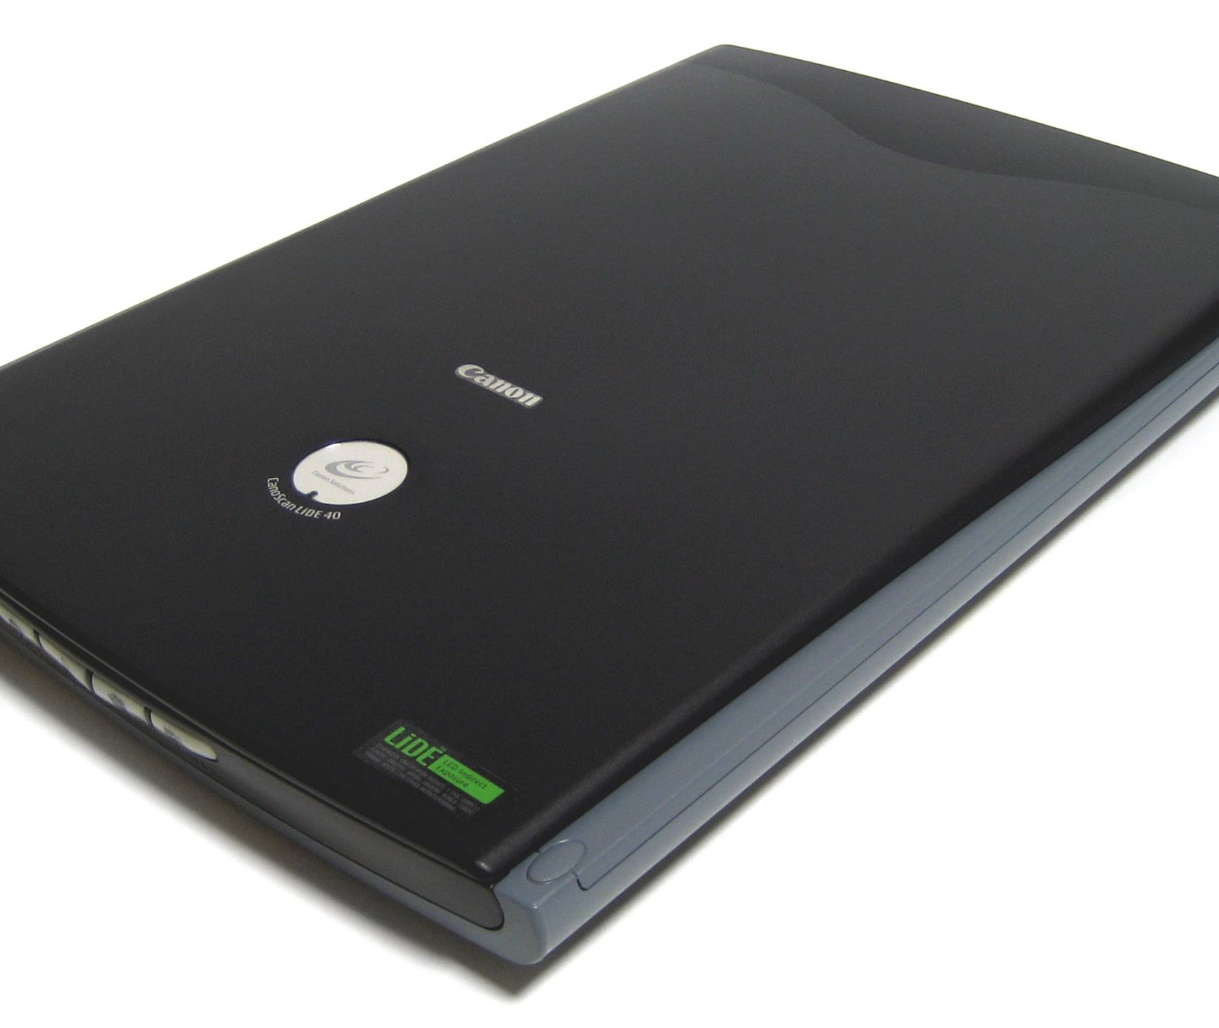
Scanner
Input device used to computerize an image
It sends a light pattern to the scanned image and captures the reflected light pattern to computerize the image

Slide 8
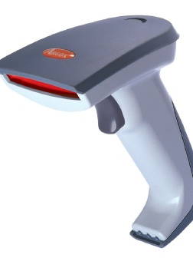
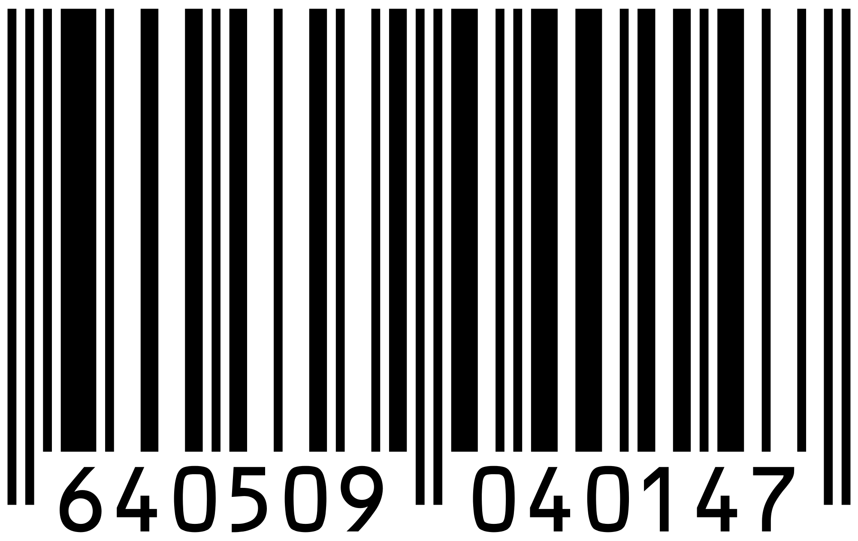
Bar Code Reader
Optical technology used to read data printed in a line pattern
Used to input data fastly to a computer system
Most of the time barcodes are used in super markets for stock controlling

Slide 9
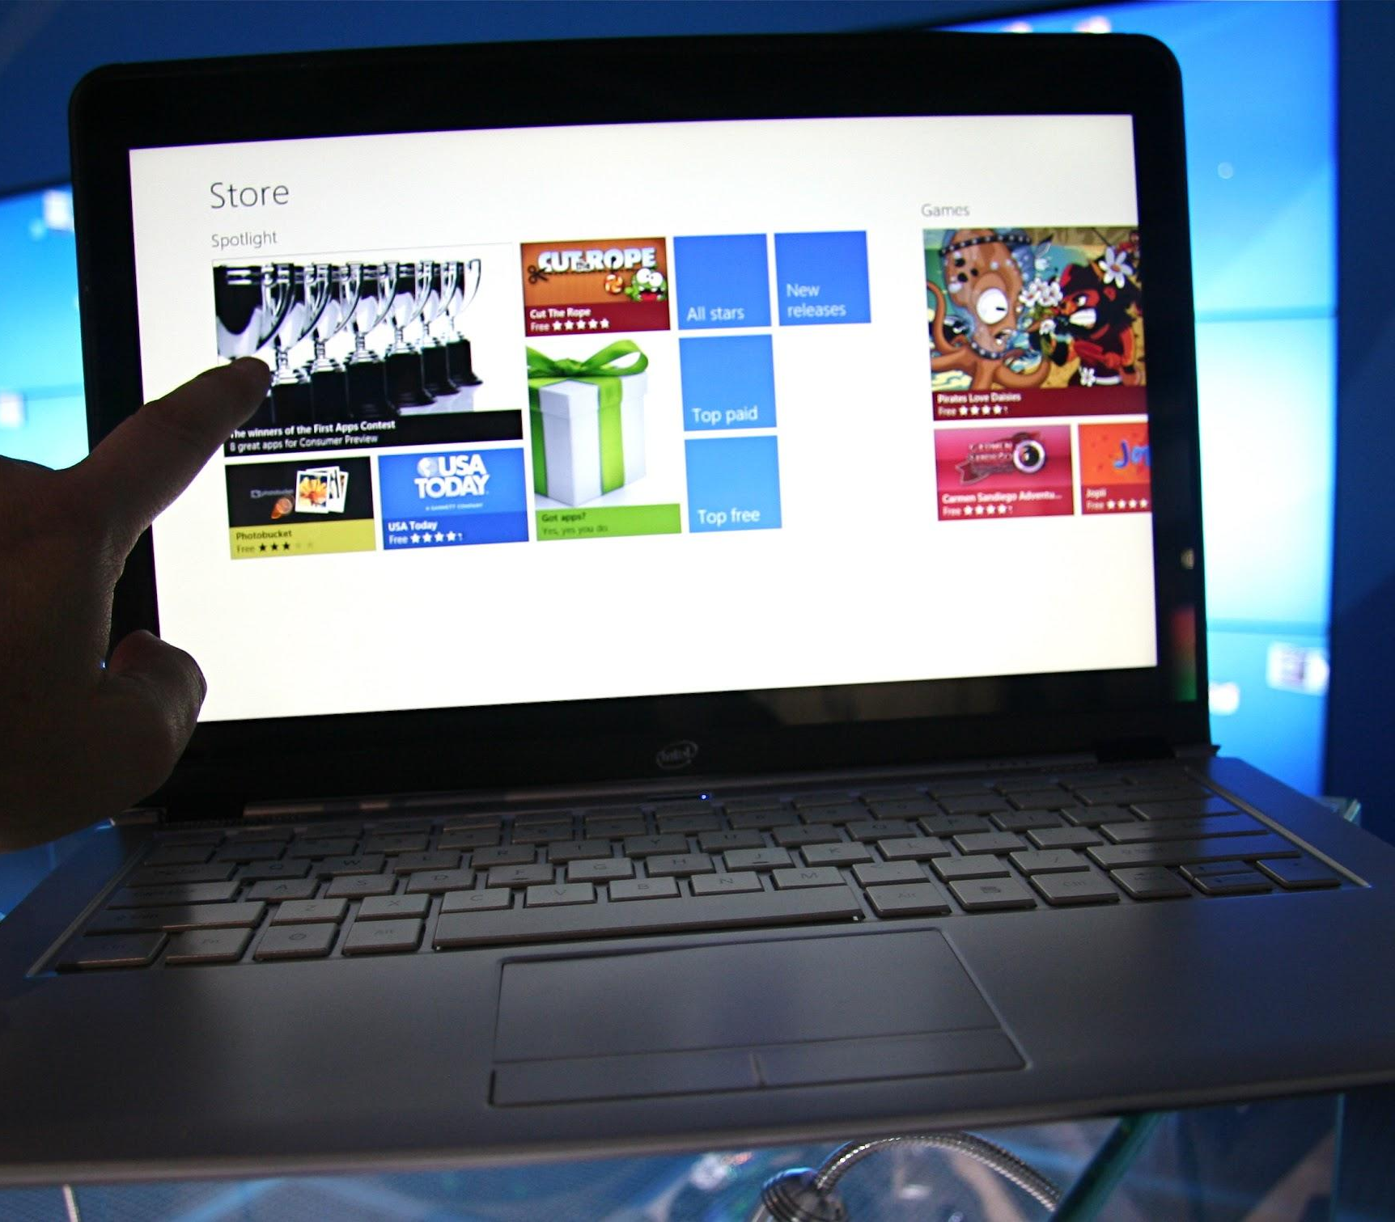
Touch Screen
It identifies the touch of your finger and that touch will be taken as an input to the system
Touch Screen is categorized under both Input and output devices.
ATM machines, Mobile phones, laptops and tablets has Touch screens

Slide 10
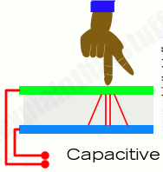
Capacitive Touch Screen
The whole screen is like a capacitor.
When you bring your finger up close, you affect the electric field that exists between the inner and outer glass

Slide 11
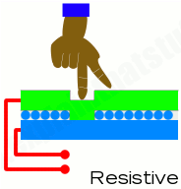
Resistive Touch Screen
When you press a resistive touchscreen, you push two conducting layers together so they make contact, a bit like an ordinary computer keyboard

Slide 12
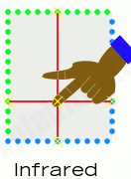
Infrared Touch Screen
When your fingers move up close, they break invisible beams that pass over the surface of the screen between LEDs on one side and photocells on the other.

Slide 13
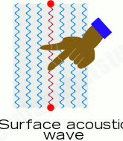
Surface acoustic wave touch screen
A surface-sound wave screen, but your finger interrupts high-frequency sound beams rippling over the surface

Slide 14

Pixel
Smallest element of a digital image called Pixel
It derived from the term “Picture Element”
Set of pixels create a digital image

Slide 15
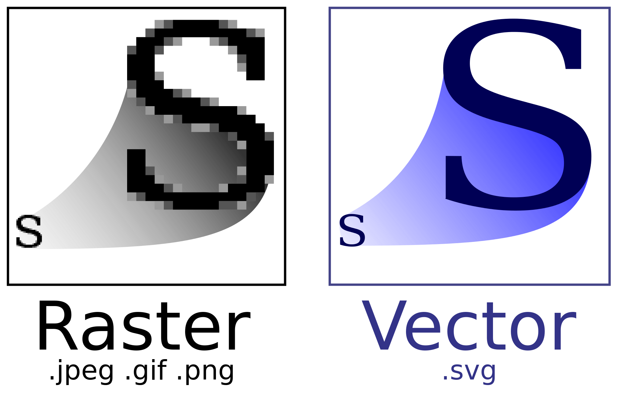
Digital Images

Slide 16
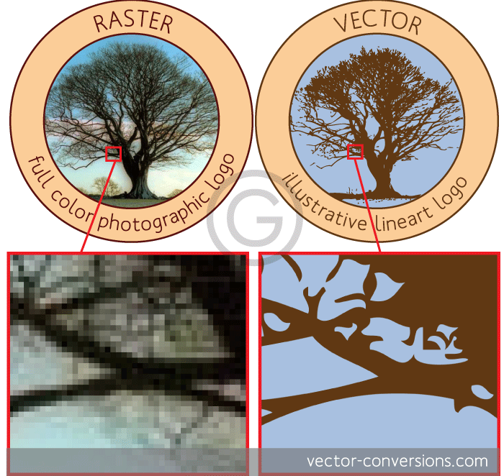

Slide 17
Vector and Raster
Vector
Pixel-based
Images are based on pixels
Raster programs best for editing photos
Raster
Can be easily converted to raster
Shapes based on mathematical calculations
Vector programs best for creating logos, drawings and illustrations, technical drawings.

Slide 18
Resolution
Resolution = No of pixels horizontal axis X No of pixels in
vertical axis
Example :
If screen has 800 horizontal pixels and 600 pixels in vertical axis the resolution is 800x600
Sharpness of the image on a depends
  on the resolution size of the monitor.
  Size of the monitor
(Same pixel resolution will be sharper on a smaller monitor than a larger)
Number of dots (pixels) contained on a display or an image

Slide 19
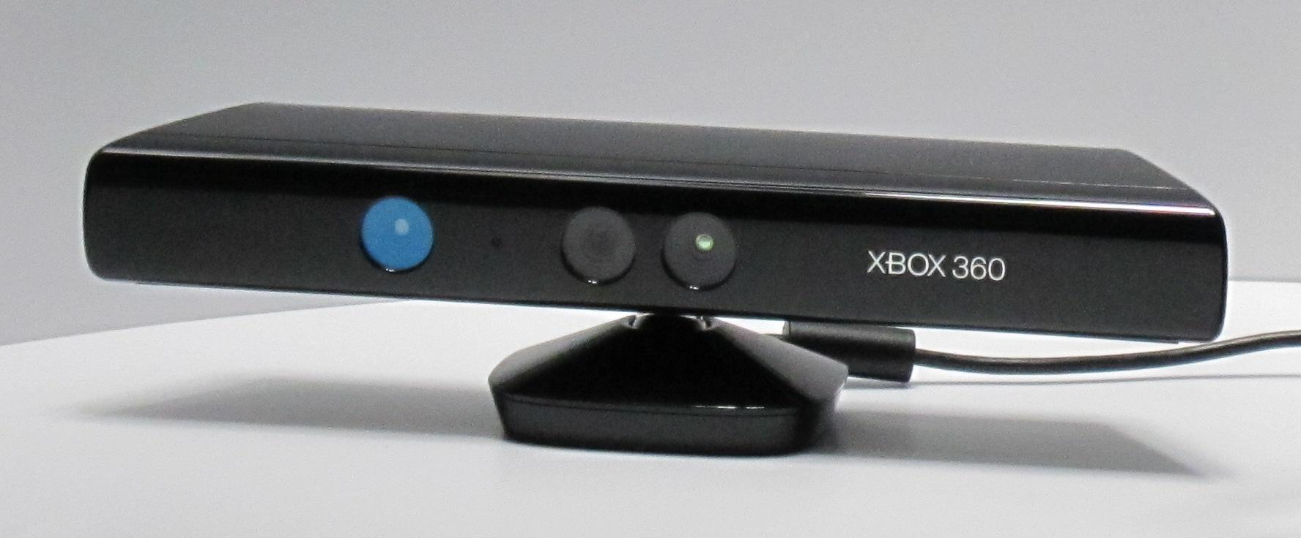
Kinect Sensor
Input device used to capture the gesture and posture of set of persons
Used with XBOX and Virtual reality applications
Produced by Microsoft
It can be identify by Hand movements and gestures of 32 persons same time

Slide 20
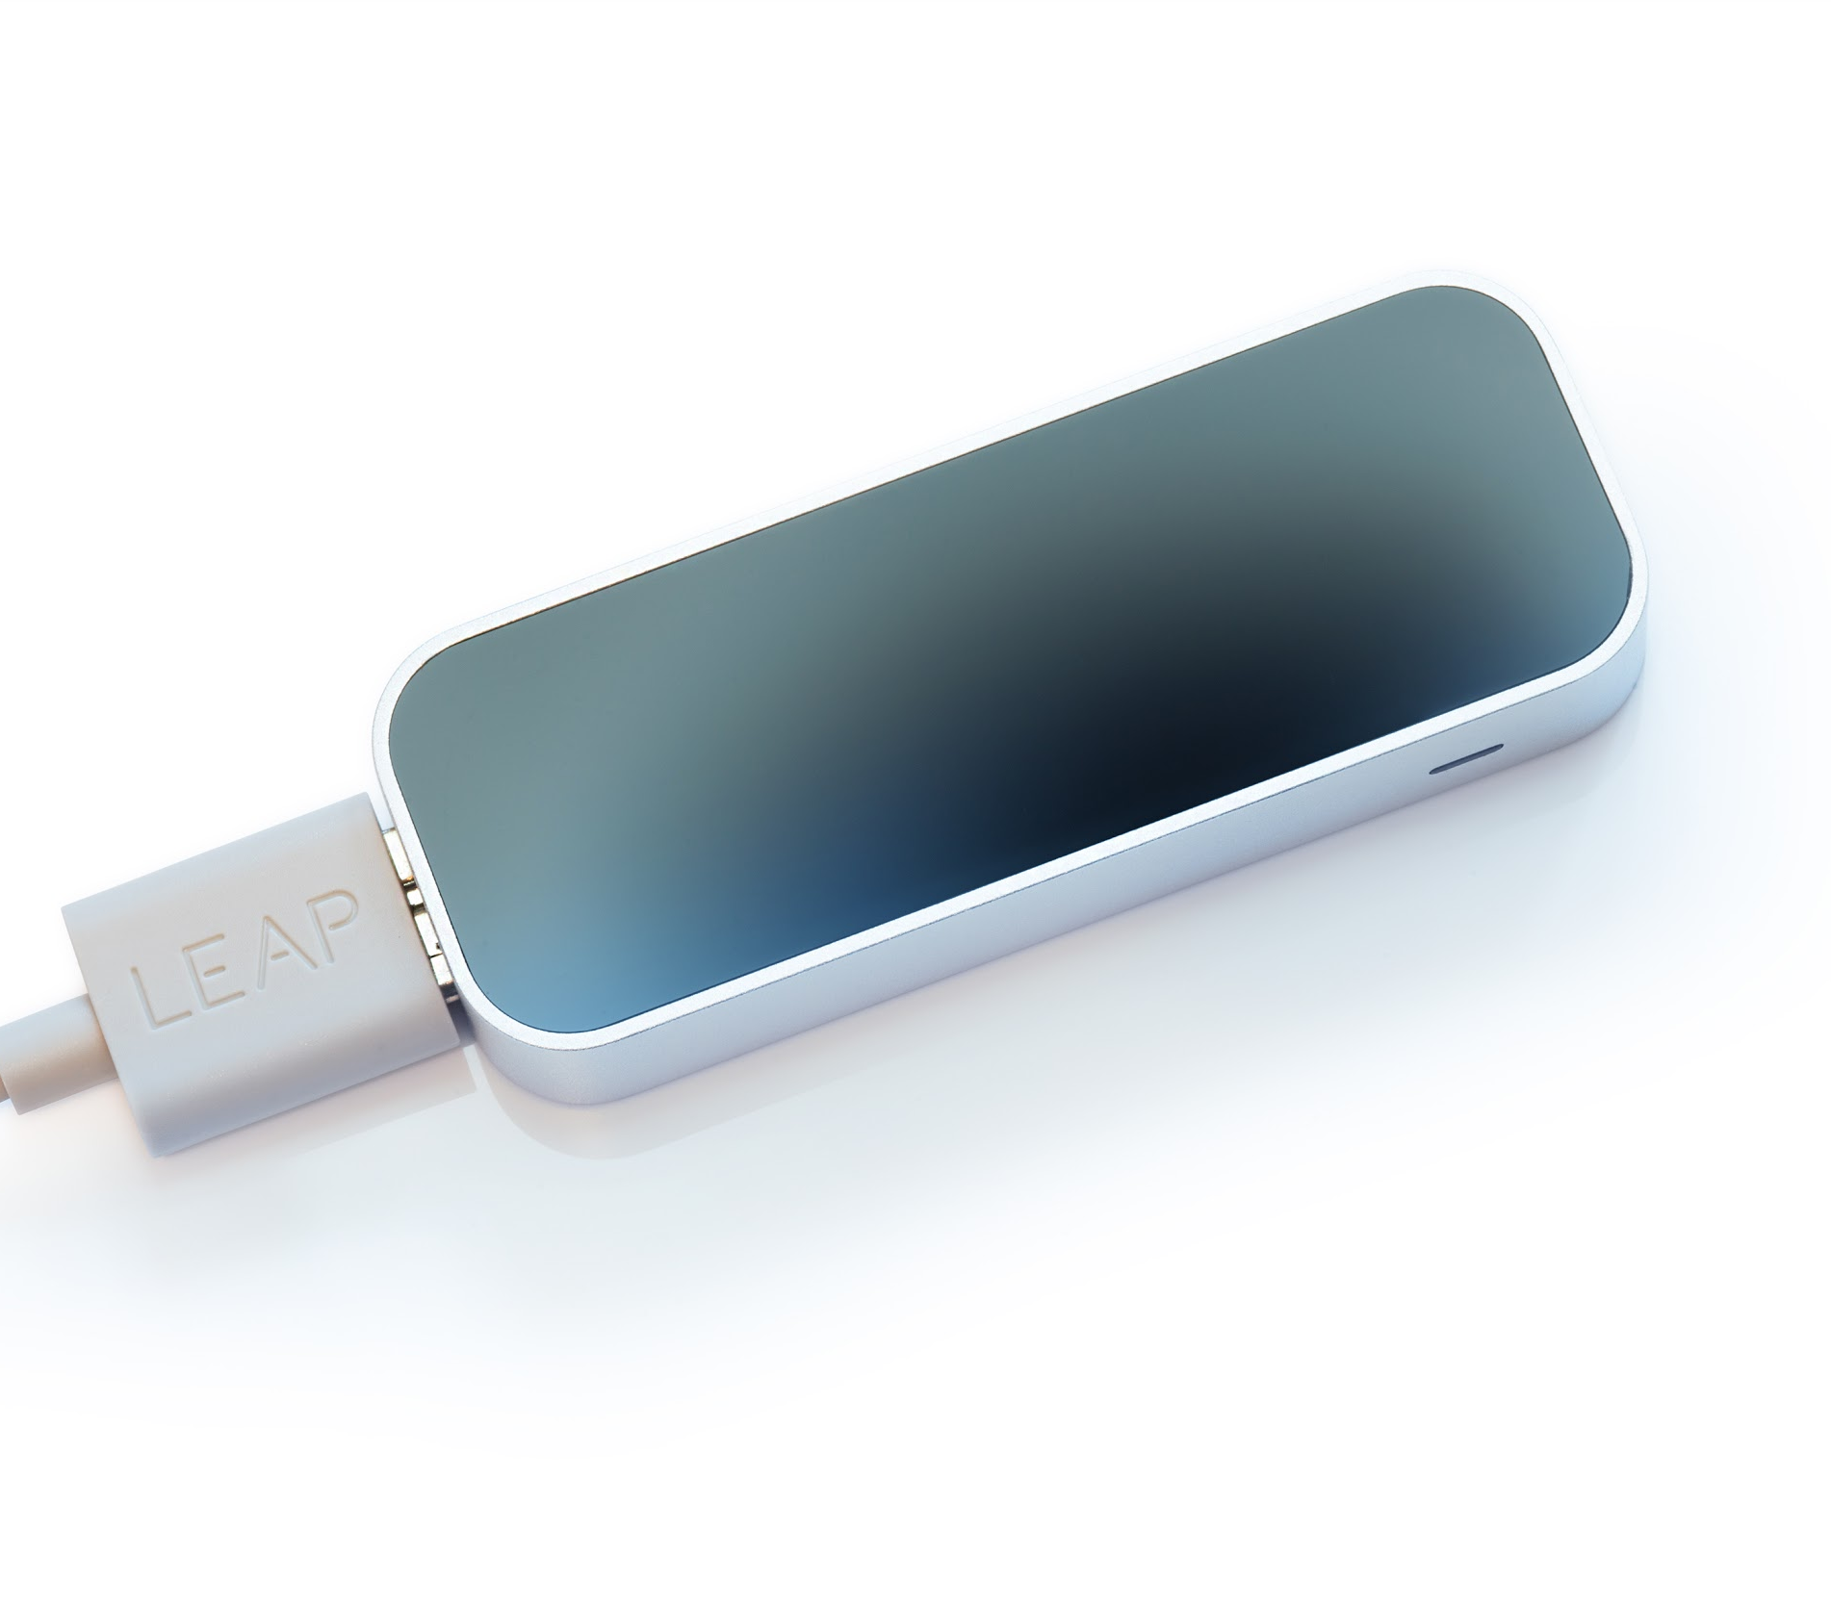
Leap Motion Sensor
Device which capable of capturing hand movements and finger moments and input them to computer same like a Mouse.
But this device do not require any touch or contact with the device.
Device detects hand motions and finger motions with out direct contact
Used in virtual reality applications

Slide 21
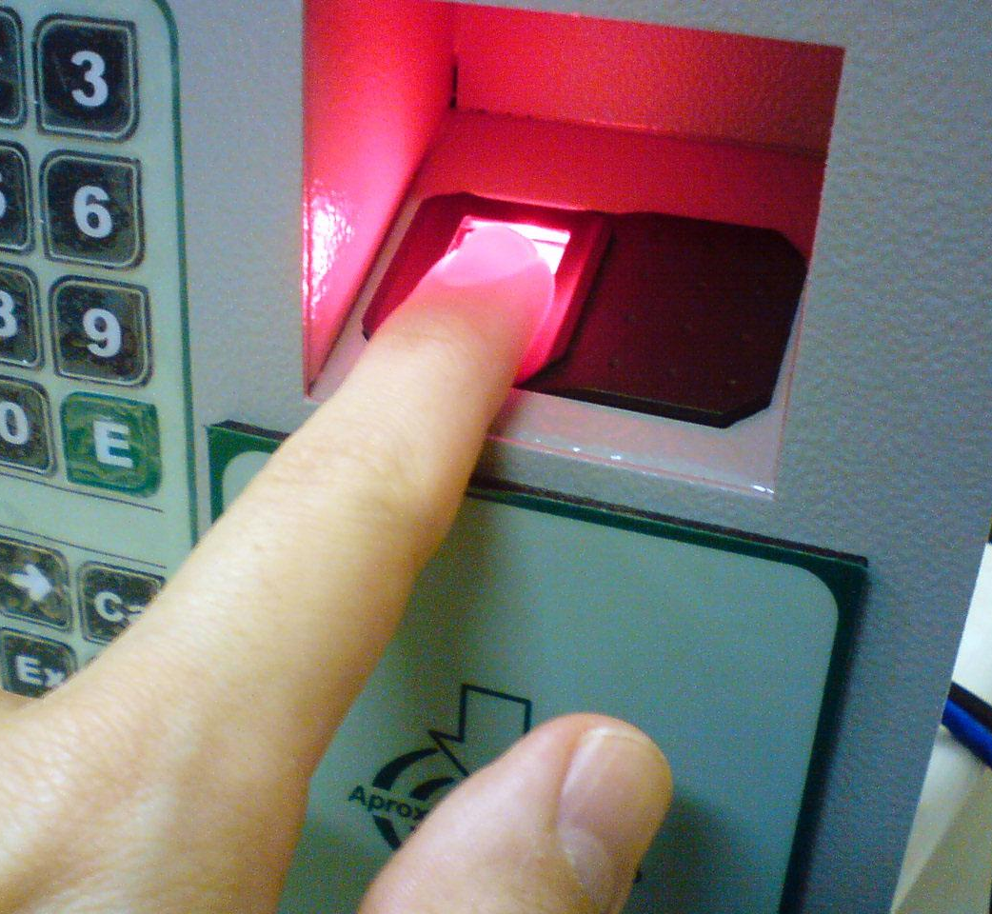
Fingerprint Scanner
Used to identify a person with biometric measurements
Most of the employee attendance record systems and access controlling systems are using this device.

Slide 22
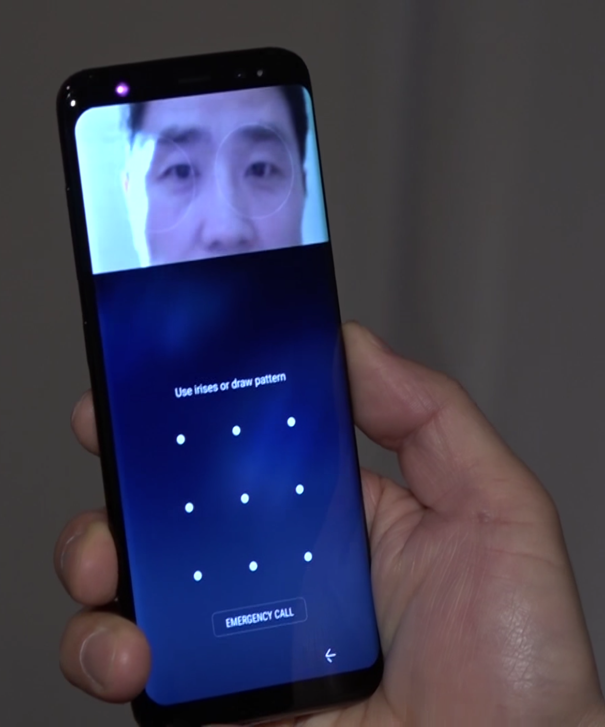
IRIS Scanner
The device which used to read the pattern in the human IRIS
Pattern in human IRIS can be used to identify a person unique from others
Used in controlling physical access to a location and access controlling

